Slide 1

Criminal Citations in Lieu of Arrest Best Practices

Slide 2
Objectives
Identify non-traffic offenses for which a written citation may be issued in lieu of a physical arrest.
Identify when a criminal citation can be used in lieu of an arrest.
Identify the procedures for issuing a citation and releasing at the scene or making the physical arrest and releasing on citation from booking.
In a practical exercise select the appropriate charge and complete a criminal citation.

Slide 3
Criminal Citations in Lieu of Arrest
Maryland Law allows Police Officers and Deputies to issue criminal citations, instead of a physical arrest, in certain circumstances.
The law governing criminal citations is found in Criminal Procedure Article, Section 4 – 101.
In addition to MD State Law individual Agencies may also have policies governing the issuance of criminal citations. It is incumbent upon each Officer or Deputy to know their agency's policy.

Slide 4
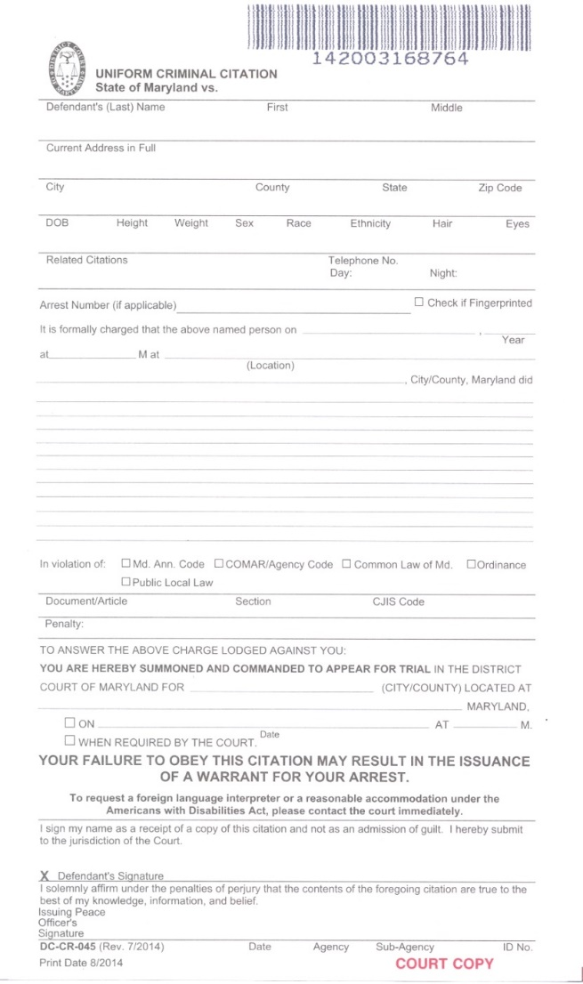
Maryland Uniform Criminal Citation
The State of Maryland Uniform Criminal Citation (Form DC/CR 45) is designed to provide a single format on which police officers can charge an adult offender with violations of certain petty misdemeanor criminal codes and statutes. This applies to State Laws, County Codes or Local Ordinances. The Adult Criminal Citation may only be used to charge adult violators.

Slide 5
Criminal Procedures Article Section 4–101
(c) Citation by Police Officer
Police Officer has the meaning stated in 2-101 of the Criminal Procedures Article
(1) (i) Subject to paragraph (2) of this subsection, in addition to any other law allowing a crime to be charged by citation a police officer shall charge by citation for:
1. Any misdemeanor or local ordinance violation that does not carry a penalty of imprisonment;
2. Any other misdemeanor or local ordinance violation not involving serious injury or an immediate health risk for which the maximum penalty of imprisonment is 90 days or less.
Notes:
Fire Marshals can also issue Criminal citations for offenses related to their duties.

Slide 6
Criminal Procedures Article Section 4–101
3. possession of marijuana under § 5-601 of the Criminal Law Articles.
(ii) Subject to paragraph (2) of this subsection, in addition to any other law allowing a crime to be charged by citation, a police officer may charge by citation for:
1. sale of an alcoholic beverage to an underage drinker or intoxicated person under § 6-304, § 6-307, § 6-308, or § 6-309 of the Alcoholic Beverages Article;
2. malicious destruction of property under § 6-301 of the Criminal Law Article, if the amount of damage to the property is less than $500;

Slide 7
Criminal Procedures Article Section 4–101
3. misdemeanor theft under § 7-104(g)(2) of the Criminal Law Article; OR
4. Possession of a controlled dangerous substance other than marijuana under 5-601of the criminal law article

Slide 8
Criminal Procedures Article Section 4–101(c)(2)
2) A police officer may charge a defendant by citation only if:
  (i) the officer is satisfied with the defendant's evidence of identity;
  (ii) the officer reasonably believes that the defendant will comply with the citation;
  (iii) the officer reasonably believes that the failure to charge on a statement of charges will not pose a threat to public safety;
  (iv) the defendant is not subject to arrest
  1. an alleged misdemeanor involving injury or immediate health risk or an alleged felony arising out of the same incident; or
  2. based on an outstanding arrest warrant; and
  (v) the defendant complies with all lawful orders by the officer.

Slide 9
Criminal Citation
Based on the updated law, effective 10/01/21 Officers can issue more than one citation to a defendant that commits more than one offense during the same incident. The second or subsequent offense must meet the criteria for the issuance of a criminal citation.
Example – you respond to a shoplifting and the suspect had been previously banned from the store.
  It is verified that the shoplifting is less than $100.00
  It is confirmed that the suspect is trespassing
  An Officer can issue two criminal citations, one for the theft and one for the trespassing.

Slide 10
Criminal Procedures Article Section
4–101(c)(3)
(3) A police officer who has grounds to make a warrantless arrest for an offense that may be charged by citation under this subsection may:
  (i) issue a citation in lieu of making the arrest; or
  (ii) make the arrest and subsequently issue a citation in lieu of continued custody.

Slide 11
Criminal Procedures Article Section 4–101
Offenses that qualify for a Criminal Citation
Trespassing CR 6–403
Destruction of Property under $500 CR 6–301
Theft under $100 CR 7–104
Possession of Marijuana 10 grams or more CR 5–601(a)(1)
Disorderly Conduct CR 10 – 201(c)(2)
Urinating in Public (Local Ordinance)
Disturbing the Peace CR 10–201
This List is not all inclusive. Officers are reminded to check with their local Agency for qualifying ordinances.
Notes:
Most commonly used by Law Enforcement

Slide 12
Criminal Procedures Article Section 4–101(c)(1)(i)(2)
Offenses that do not qualify for the issuance of a criminal citation
  Failure to comply with a peace order under 3-1508 of the Courts Article.
  Failure to comply with a protective order under 4-509 of the Family Law Article.
  Violation of an out-of-state domestic order under 4-508.1 of the Family Law Article.

Slide 13
Criminal Procedures Article Section
4–101(c)(1)(i)(2)
Offenses that do not qualify for the issuance of a criminal citation
(cont.)
  possession of an electronic control device after conviction of a drug felony or crime of violence under § 4-109(b) of the Criminal Law Article
  abuse or neglect of an animal under § 10-604 of the Criminal Law Article

Slide 14
Remember!
Before a criminal citation can be issued:
  The Officer must have positively identified the defendant
  The violation must qualify under the criminal procedure article as an offense for which the criminal citation can be issued
  The Officer reasonably believes that the defendant will comply with the citation
  There is no outstanding warrant, felony charge or misdemeanor charge involving a serious injury or immediate health risk

Slide 15
Criminal Citation
Signature by the defendant
The failure of the defendant to sign does not invalidate the charging document; that being the criminal citation. In this instance the officer can write refused on the defendant signature line, document the refusal in the statement of probable cause and in the report, then release the defendant.
Some Agencies’ Policies indicate that if the defendant refuses to sign make the arrest. The Policies regard the failure to sign as failing to comply with the citation.(Refer to your Agency Policy)
Notes:
The failure of a defendant to sign the criminal citation can be treated similarly to a defendant refusing to sign a traffic citation. If the defendant meets all the other requirements and is other wise cooperative the Officer may write refused on the defendant’s signature line and issue the citation.

Slide 16
Uniform Criminal Citation DCCR-045
In addition to meeting the requirements set forth in Criminal Procedures Article 4-101 Officers should complete a
Wanted/warrant check
Use Secure Case Search to search MD Judiciary. The public case search does not contain all the information Officers require.
(Officers can receive access to secure case search through the District Court IT Department)
Notes:
Secure Case Search can be accessed from any computer that is connected to the internet. If your MDT is able to connect to the internet you can access the MD Judiciary Secure Case Search from there.
Be mindful that if you use a public computer and you do not logout of secure case search and close the browser it will allow some who comes behind you to hit the back button and access your log in. It is not recommended to use a public computer to access MD secure Case Search.

Slide 17

Uniform Criminal Citation DCCR-045

Slide 18
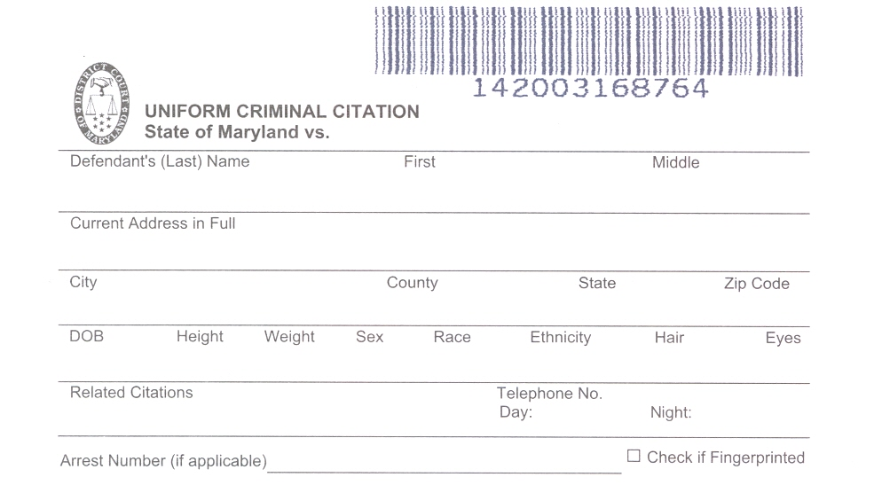

Uniform Criminal Citation DCCR-045
When completing the hand written citation fill in the appropriate information
Whitfield
Wilbur
Rufus
600 North Anywhere Street
Sykesville
Carroll
MD
21784
12/25/2000
5’10
195
M
2
Blank
BRN
BLU
Indicate any traffic, civil, or other related criminal citation # here
Indicate a phone #
Report Number or Arr # Here
Notes:
Under arrest number the issuing agency can use the incident report number or if their agency uses arrest numbers enter the arrest number

Slide 19
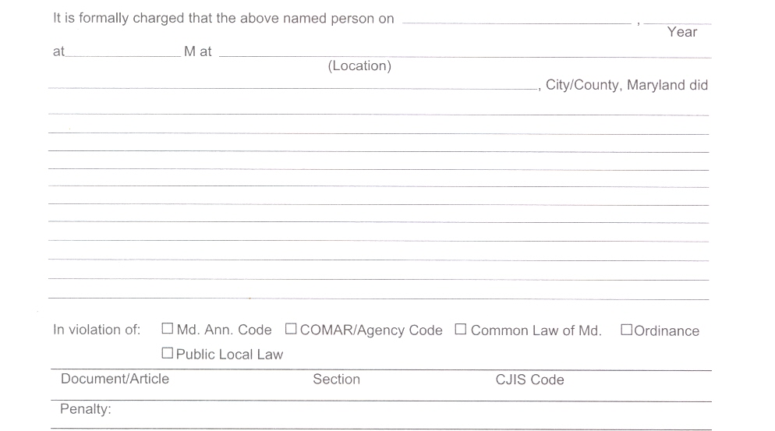
Uniform Criminal Citation DCCR-045
Date Occurred
Year Occurred
Standard Time
Address Offense Occurred
City or County Where Offense Occurred
… steal ______________ (property or service) of ______ (owner) having a value of less
than $100.00.
Enter the wording as it appears in the Commissioner Charging Manual
Check the box for the source document
X
Enter the Article Section and CJIS Code from the Charging Manual
CR
7–104
*1_0521*
This entry is not required but can be recorded from the charging manual

Slide 20
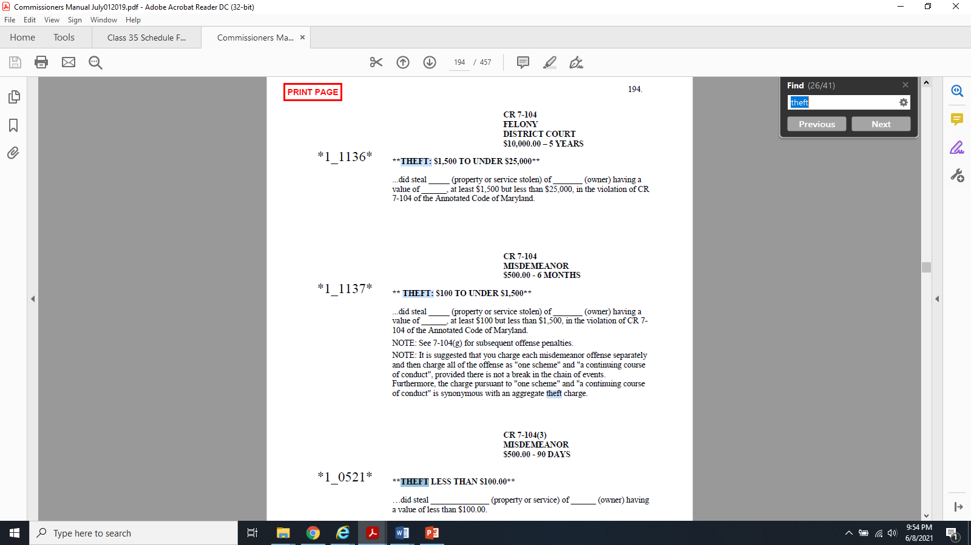
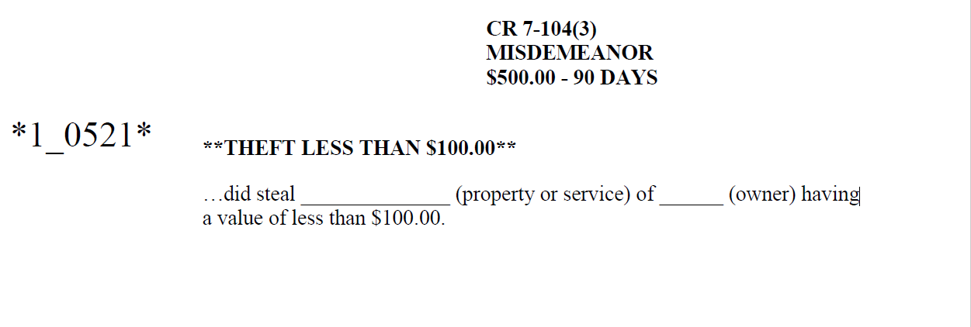
The charging language can be found on line at https://www.courts.state.md.us/district/directories/commissionermap
Locate the wording for the appropriate charge and enter the wording on the citation
Article/Section
CJIS Code

Slide 21
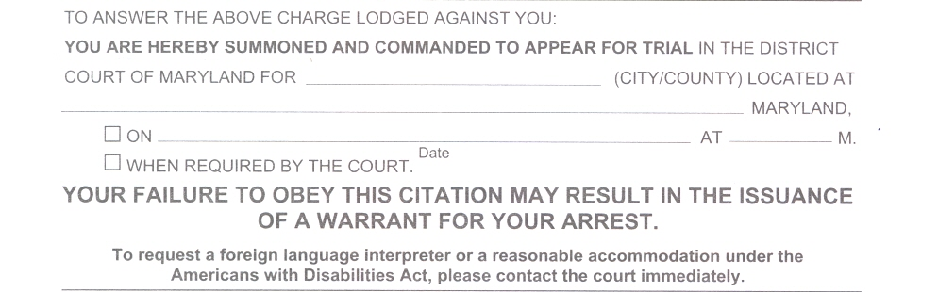
Uniform Criminal Citation DCCR-045
Carroll
___
101 N. Court Street Carroll County 21157
X
Enter the District Court for the Jurisdiction where the offense occurred Strike through City or if it occurred in Baltimore City strike through County. Enter The Court Address that you attend, Check off when required by the court.

Slide 22
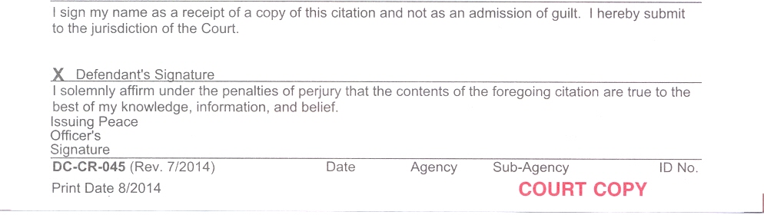
Uniform Criminal Citation DCCR-045
Defendant’s Signature
Off Signature
Date issued
Agency Code
Sub Agency
OFF’s ID #
Complete the bottom with your information, signature, date issued Agency code, Sub-Agency and ID#.
Have the defendant sign by defendant’s signature.
Notes:
Remember the failure of a defendant to sign the criminal citation can be treated similarly to a defendant refusing to sign a traffic citation. If the defendant meets all the other requirements and is other wise cooperative the Officer may write refused on the defendant’s signature line and issue the citation. Then document in the report and probable cause statement

Slide 23
Uniform Criminal Citation DCCR-045
Wilbur Rufus Whitfield
Off P. Malloy
5-26-2021
AE
PC# 7
#3014

Slide 24
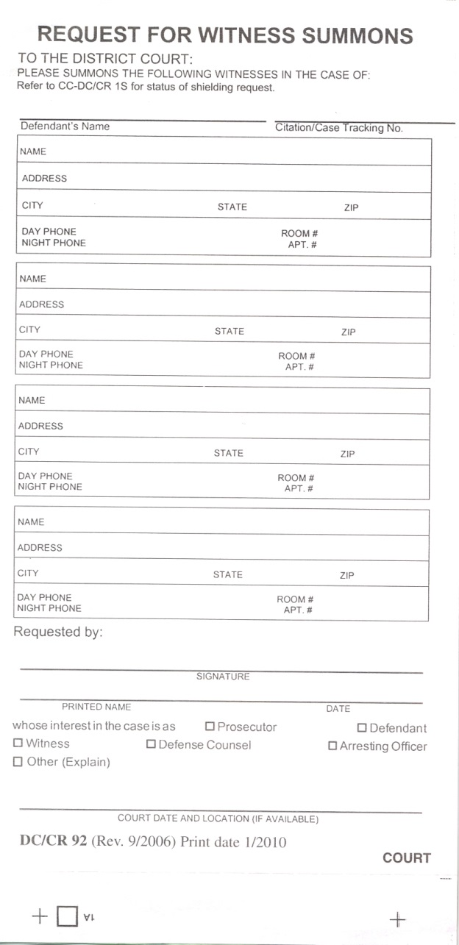
Uniform Criminal Citation DCCR-045
Witnesses to be Summonsed
On the rear of the Court copy, you will find the section to request summonses for witnesses. Complete the blocks as necessary for witness Officers only. If it is necessary to summons a civilian witness, use the standard District Court summons form DC/CR 92.

Slide 25
Uniform Criminal Citation DCCR-045
The rear of the State’s Attorney’s copy must be completed. It must describe the events surrounding the issuance of the citation. If more room is necessary to complete the statement the officer may continue on a DCCR 4A, Statement of probable cause continuation.

Slide 26
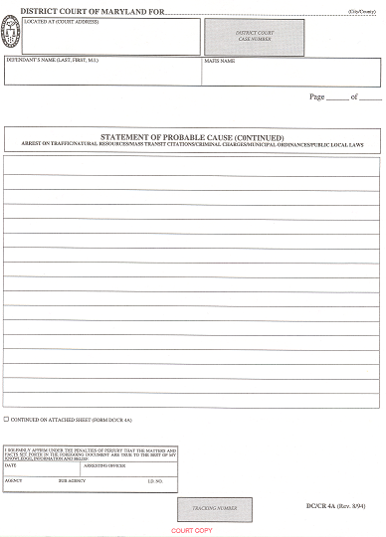
Uniform Criminal Citation DCCR-045
The Officer may elect to write, “See attached DCCR 4A” and complete the entire statement on the continuation sheet.

Slide 27
Uniform Criminal Citation DCCR-045
Note: Some Agencies have an agreement with the State’s Attorney's Office for their jurisdiction that allows Officers to complete the narrative supporting the issuance of the citation in an incident report. The State’s Attorney’s Office has direct access to the reporting system and accesses the narrative directly.

Slide 28
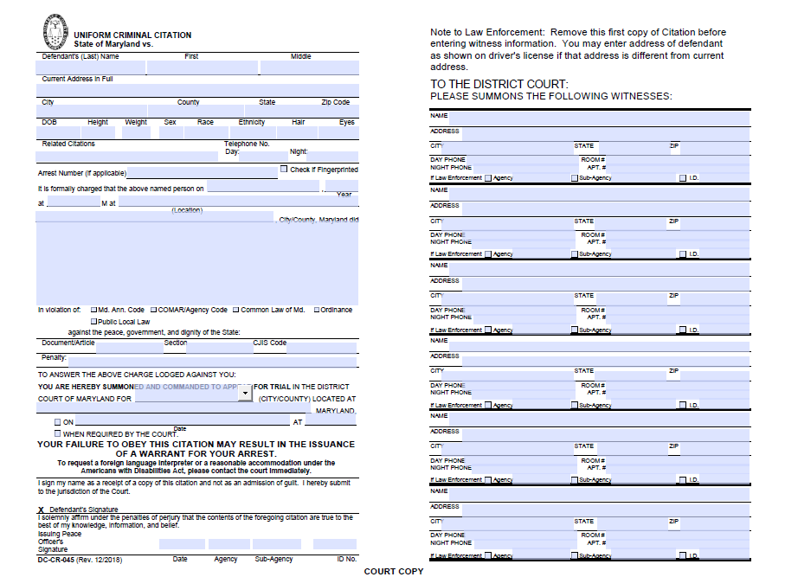
Criminal Citation DCCR-045 Digital Version

Slide 29
Criminal Citation DCCR-045 Digital Version
Digital Citations are now an option
Officer will fill out PDF version
Officers MUST use the tracking number from a pre-printed DC/CR 45 and type that number into the PDF version.
The pre-printed/pre-numbered DC/CR 45 from the citation book will have a diagonal line drawn across it and will be stapled to the Court copy of the PDF version.

Slide 30
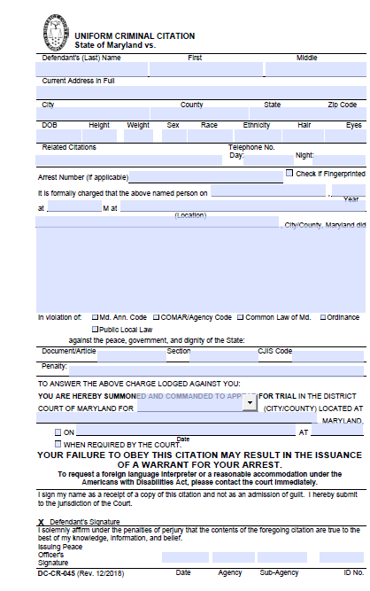
Criminal Citation DCCR-045 Digital Version
This Citation number
142003168764
goes here on the electronic version

Slide 31
Criminal Citation DCCR-045 Digital Version
The digital version of the Criminal Citation may be accessed through any computer that has internet access and an attached printer.
Go to MD Court Home page.
Click on Courts tab.
Locate District Court on the Drop down and Click on it.
On the left hand side locate the tab that reads Law enforcement.
Enter the user name and password.
Locate the DCCR 045 and click on it and a fillable pdf version will open.
Complete the criminal citation and print it out.
Notes:
****** If your Police vehicle is equipped with an e-tix printer, you have access to the internet you can use the digital version in the field.
User name – leforms password – comm

Slide 32
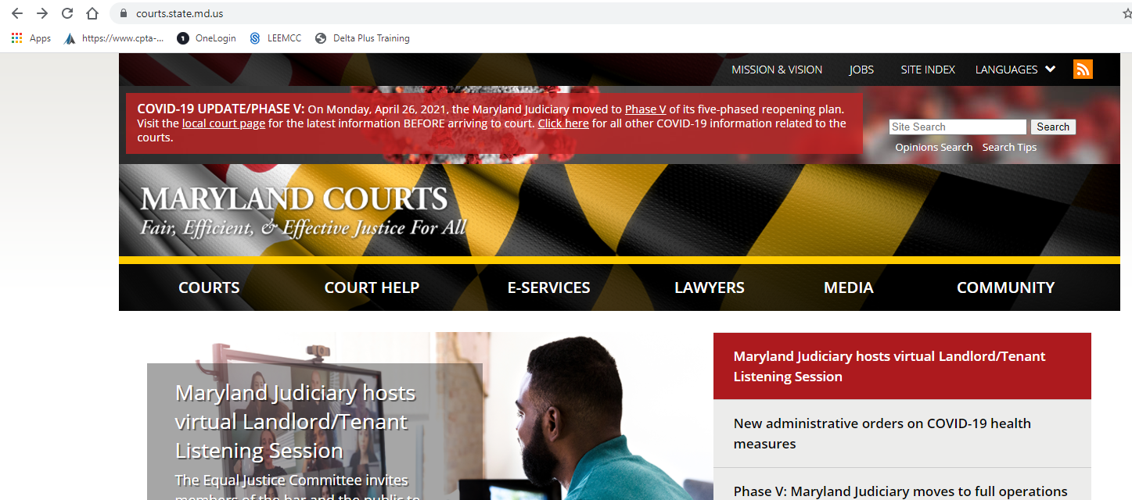
Click here

Slide 33
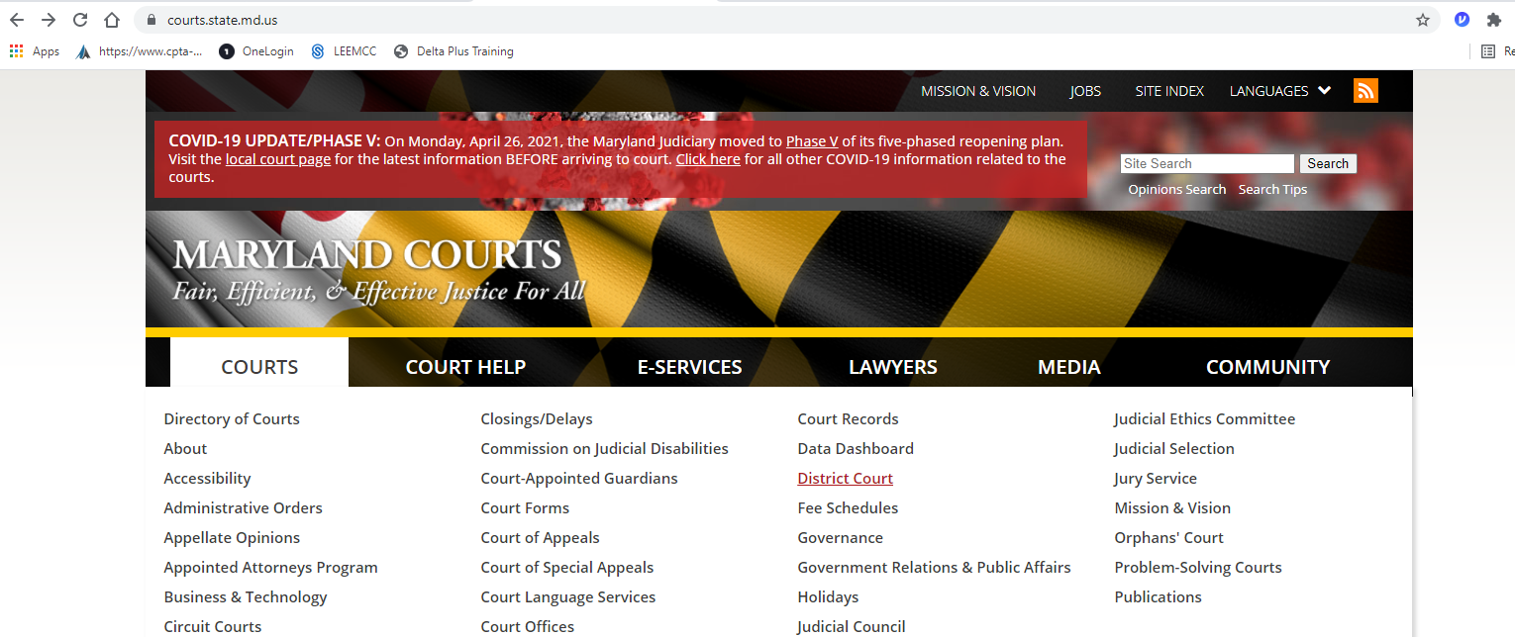
Click here

Slide 34
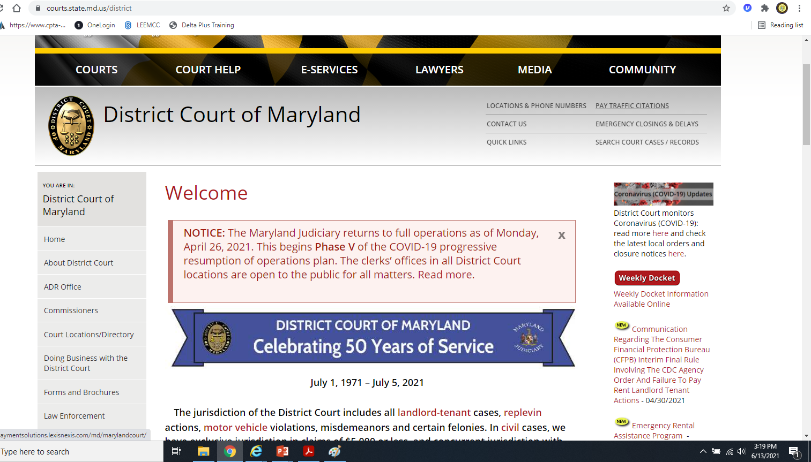
Click here
Notes:
Username leforms
Password comm

Slide 35
Criminal Citation DCCR-045 Digital Version
Scroll down to Fillable Uniform Criminal Citation DCCR–045 and click on it, the form will open

Slide 36
Voiding A Criminal Citation
Voiding Citations:
  When a mistake is made requiring the officer to issue another citation, the citation with the mistake CANNOT be destroyed.
  Write the word: “VOID” across the citation and submit same to your Central Records/Records Keeper per your Agency’s Policy.
  Officers are again reminded to follow your Agency’s protocols when voiding a Criminal Citation.

Slide 37
Questions

Slide 38
Practical Exercises
From the information given on the slide, write a Criminal Citation.
Complete the citation as if you were issuing it in the field.
Complete a narrative on the rear of the State’s Attorney’s copy supporting the issuance of the citation.
Take notes as if you were on scene gathering information.
You will have several minutes to write down whatever information you may need from the slide to complete the citation.
Only use the information on the slide, Do not add any information about a person’s identity.
Notes:
NOTE: Instructor may choose to use only a few of the six practical exercises. It is suggested to use a minimum of 4.
Instructors may develop their own scenarios that reflect incidents that are more likely to be encountered in their jurisdiction

Slide 39
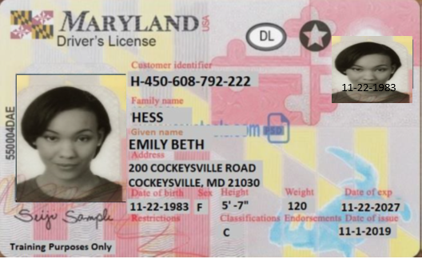
Practical Exercise #1
Complainant (Wal-Mart Asset Protection) (410) 555-2233 (W)
Suspect (443) 555-2221
Theft from Wal-Mart at (location in your jurisdiction).
Suspect stole 1 jacket from men’s department worth $75.00.
Suspect has no prior theft cases.
Suspect meets the criteria for a criminal citation.
Date of Theft: Today’s Date Time of Theft: Time Right Now
Report #: 21-74XXXX( Your ID#) Incident #: 21-001001 Report Time: Time Right Now
District Court for your jurisdiction
Notes:
Images for training licenses obtained from MVA’s website for real ID’s.

Slide 40
Practical Exercise #2
Suspect (443) 555-2223
Purchased cigarettes (1 pack of Marlboro & 1 pack of Newport) for a Minor (Stephanie Kane Smith DOB-09/12/2008).
Occurred at (gas station or convenience store in your jurisdiction .
You responded from a citizen’s complaint.
Date of Incident: Today’s Date Time of Incident: Time Right Now
Report #: 17-75XXXX( Your ID#) Incident #: 17-001003 Report Time: Time Right Now
DISTRICT COURT address of your jurisdiction
Notes:
Images for training licenses obtained from MVA’s website for real ID’s.

Slide 41
Practical Exercise #3
Suspect (410) 555-2233
You are on patrol and observe aerial fireworks coming from the backyard of suspect’s address.
Date of Incident: Today’s Date Time of Incident: Time Right Now
Report #: 16-76XXXX (Your ID#) Incident #: 16-001004 Report Time: Time Right Now
DISTRICT COURT for your jurisdiction
Notes:
Images for training licenses obtained from MVA’s website for real ID’s.

Slide 42
Practical Exercise #4
Suspect
Emily Beth Hess
W/F D.O.B. 11-22-1983
5’07 120 lbs. Brn hair, Brn eyes
Address 200 Cockeysville Road
Cockeysville, MD 21030
Negative NCIC and Local
Cell # (443) 555-2221
Work #(410) 240-1464
Complainant (CVS Pharmacy Store manager) (410) 555-2233 (W)
Theft from CVS (location in your jurisdiction).
Suspect stole $50.00 worth of merchandise (Norelco Electric razor – $25, baby formula – $25.
Suspect has no prior theft cases.
Suspect does not have identification
Date of Theft: Today’s Date Time of Theft: Time Right Now
Report #: 21-XXXXXX( Your ID#) Incident #: 21-XXXXXX Report Time: Time Right Now
District Court for your jurisdiction
Notes:
Images for training licenses obtained from MVA’s website for real ID’s.

Slide 43
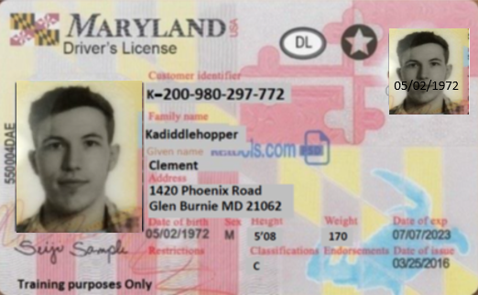
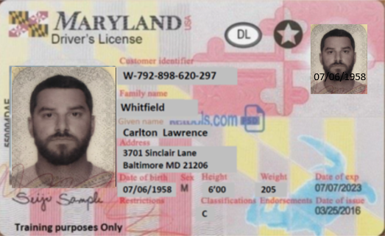
Practical Exercise #5
Complainant (Kohl’s Asset Protection) (410) 555-5600 (W)
Suspect (443) 555-2221
Theft from Kohl’s at (location in your jurisdiction).
Suspect stole 1 Raven’s jersey from men’s department worth $90.00.
Suspect has 2 prior theft cases.
Suspect meets the criteria for a criminal citation.
Suspect refuses to sign the citation
Date of Theft: Today’s Date Time of Theft: Time Right Now
Report #: 21-XXXXXX( Your ID#) Incident #: 21-XXXXXX Report Time: Time Right Now
District Court for your jurisdiction
Notes:
Officer must decide whether to arrest or not and explain why.
Officer can write refused on citation, indicate in the report and PC that the defendant refused to sign and release.
Images for training licenses obtained from MVA’s website for real ID’s.

Slide 44
Practical Exercise #6
Complainant (Best Buy Asset Protection) (410) 555-9016 (W)
Suspect (443) 555-7438
Theft from Best Buy at (location in your jurisdiction).
Suspect stole a Sony digital media player worth $65.00.
Suspect broke a 70 inch LED TV valued at $1,500.00
Suspect has 5 prior theft cases.
Suspect is Negative NCIC and Local
Date of Theft: Today’s Date Time of Theft: Time Right Now
Report #: 21-XXXXXX( Your ID#) Incident #: 21-XXXXXX Report Time: Time Right Now
District Court for your jurisdiction
Notes:
Officer must decide whether an arrest should be or should not be made
Officer should make the arrest because the property destroyed is valued at $1500
Images for training licenses obtained from MVA’s website for real ID’s.

